Slide 1
Protecting Your Brand Online
Helen Roberts
Solicitor, Network of Firms
https://www.linkedin.com/in/helen-roberts-i-solicitor-i-maitrise-60976b10/

Slide 2
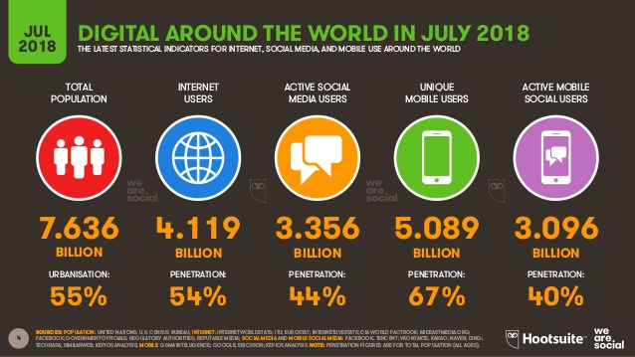

Slide 3
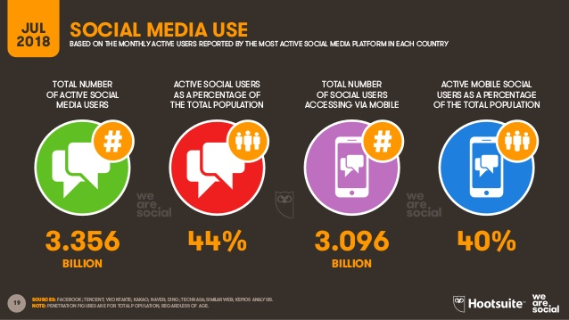

Slide 4
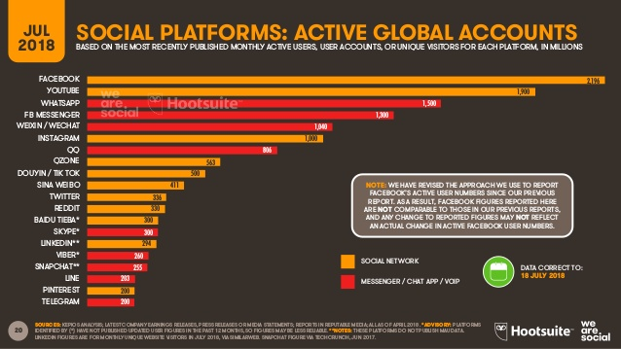

Slide 5
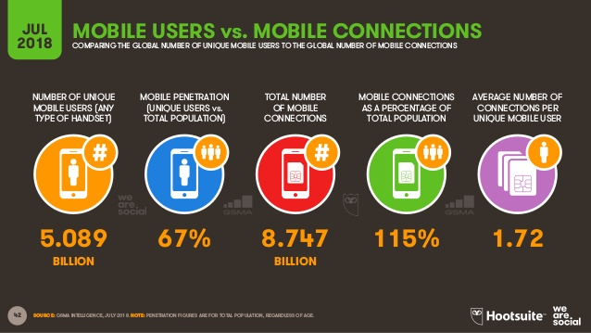

Slide 6
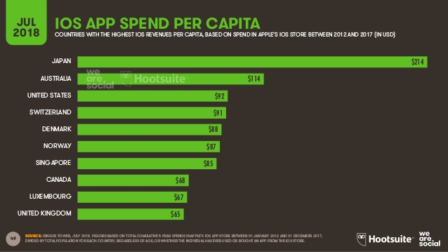

Slide 7
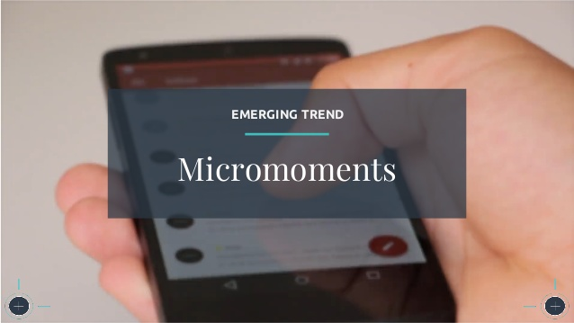

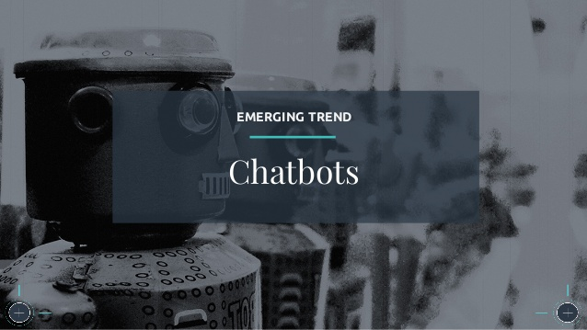
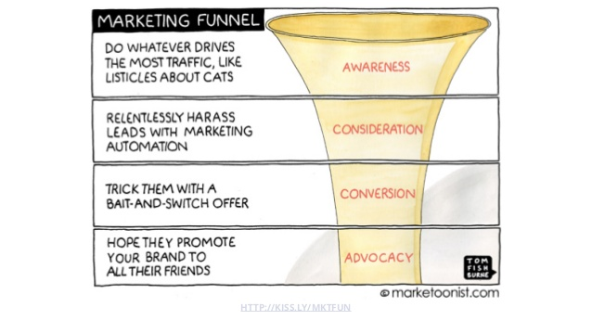

Slide 8
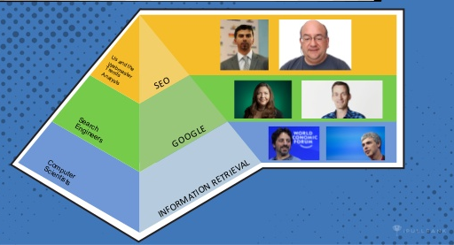

Slide 9
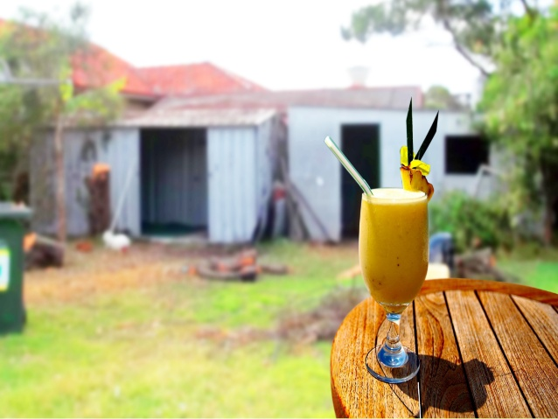

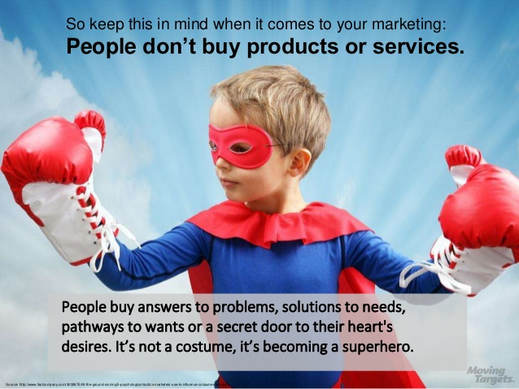
Humans need a story… what digital solutions can achieve this ?

Slide 10
Overview
  Protecting company activities
        Terms & Conditions of web service provider
        Your own site Terms & Conditions
        Potential Issues with Employee or other persons’ activities
  Tools to consider when challenging competitors
        Advertising Regulation
        Meta tags
        Colour as a trade mark
        Rights in data & ownership
        Copyright in software
        Copyright and anti-circumvention laws
        Domain names & Cybersquatting
        Design Rights
        Passing Off
        Cybersecurity & encryption
      Consumer Rights
        E-Commerce
        Data Privacy & Consent

Slide 11
Protecting Company activities
TERMS & CONDITIONS – Ownership & Control
  You publish news, photos and other material on Facebook.
  The sites' use of this material is governed by terms and conditions.
  Facebook's T & Cs grant them a licence of the IP in any content posted.
  Facebook allows only restricted use of data gathered through advertising (so cannot sell it to another company).
  Can a licence be negotiated ?
Notes:
11

Slide 12

Instagram introduced the following condition of use:
"to help us deliver interesting paid or sponsored content or promotions, you agree that a business or other entity may pay us to display your username, likeness, photos, and/or actions you take, in connection with paid or sponsored content or promotions, without any compensation to you."
Instagram had to explain that selling photos of its 100 million users was not its intention.
Notes:
12

Slide 13
Protecting Company activities
TERMS & CONDITIONS – Ownership & Control
  You are responsible & liable for content on ‘your’ website
  You must explain if you’re responsible for websites that you link with
  You may also be required to remove content from your website
  You must provide certain details on the website:
    Name.
    Address.
    E-mail address.
    Company registration number (or equivalent means of identification).
    VAT number
Notes:
13

Slide 14
Geo-blocking - online sellers must treat all EU consumers equally
Since 28 February 2018, the law prohibits businesses from discriminating on the basis of nationality, country of residence or establishment, as between potential online customers for buying goods or services in Europe.
This may no longer apply in the event of a ‘No Deal’ Brexit.

Slide 15
What contracts are recommended ?
Website development
A website development agreement should clearly define your company's functional and visual specification for the website, maintenance and support obligations, and the ownership of intellectual property rights (for example, in the design of the web pages and underlying software).
Website hosting agreements
Hosting agreements should define the scope of the services (for example, whether security, maintenance or support is provided), the specification of the server, and minimum availability requirements.
Content licences
Where your business does not own all content , it must ensure its licences with third parties are appropriate (for example, covering how the content is to be used, the territorial scope and the term of the licence).
Agreements with customers The website must include terms and conditions setting out the basis on which customers can access the site, a privacy policy and any terms of sale/service.

Slide 16
What contracts are recommended ?
Agreements for Apps
In an agreement with an app developer, the terms must explain what licences will be needed to develop and distribute the app.
To distribute the finished app through an app store, you must agree terms for a distribution agreement with the app store provider.
The largest providers (Apple, Google and Microsoft) publish them on their websites.
Customers generally accept to agree an End User Licence Agreement (EULA), which provides the terms and conditions applicable to the use of the app.
These may include certain mandatory terms stipulated by the relevant app store provider. The user must be provided with a copy of the EULA and must accept it before the user can download and use the app.
If you want to process payments through the app, you’ll need a services agreement with a third party payment services provider.

Slide 17
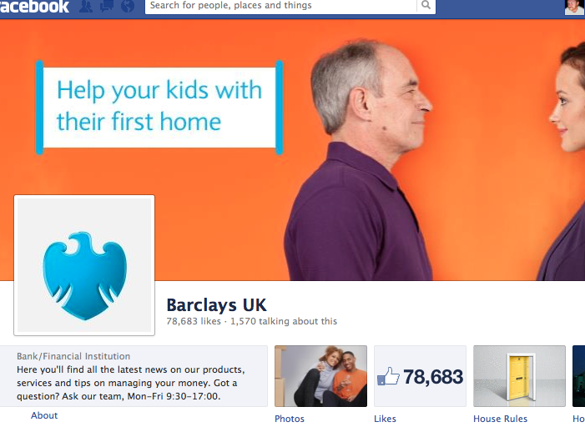
Beware of OTHERS’ TERMS & CONDITIONS
and HAVE YOUR OWN Terms of Use
Ownership of Site; Agreement to Terms of Use
These Terms and Conditions of Use (the "Terms of Use") apply to the Apple web site located at www.apple.com, and all associated sites linked to www.apple.com by Apple, its subsidiaries and affiliates, including Apple sites around the world (collectively, the "Site"). The Site is the property of Apple Inc. ("Apple") and its licensors. BY USING THE SITE, YOU AGREE TO THESE TERMS OF USE; IF YOU DO NOT AGREE, DO NOT USE THE SITE.
Apple reserves the right, at its sole discretion, to change, modify, add or remove portions of these Terms of Use, at any time. It is your responsibility to check these Terms of Use periodically for changes. Your continued use of the Site following the posting of changes will mean that you accept and agree to the changes. As long as you comply with these Terms of Use, Apple grants you a personal, non-exclusive, non-transferable, limited privilege to enter and use the Site.

Slide 18
Potential Issues with Employee or other Persons’ Activities
Complying with Company Policies & Company Brand Guidelines ?
Selling or stealing data ?
Copying or accessing customer data ?
Posting comments online in personal name ?
Cyberbullying ? Hacking ?
  Protection from Harassment Act 1997;
  The Malicious Communications Act 1988;
  The Communications Act 2003;
  The Public Order Act 1986

Slide 19
Advertising regulation – is still local even with Global Audience
  Consumer Protection from Unfair Trading Regulations (CMA)
    General – unfair commercial practices
    Specific – misleading actions – or in some way deceitful
    Prohibited – Fake/unclear advertorials
  Code of Non-broadcast advertising... (CAP)
    Legal, decent, honest and truthful
    Communications must not materially mislead or be likely to do so.
Notes:
Advertising
UNFAIR COMMERICAL PRACTICES - fails to meet the standard of "professional diligence" (the standard of skill and care that would reasonably be expected of a trader in its field of activity) and it materially impairs an average consumer's ability to make an informed decision, causing him to make a decision he would not otherwise have made.
SPECIFIC – egproviding misleading information about the main characteristics, availability or origin of a product,
BLACKLIST – do not need to show that it may have changed the average consumers mind. EG advertorials - Using "advertorials" (editorial comment to promote a product) without making it clear that the trader has paid for the promotion.
19

Slide 20
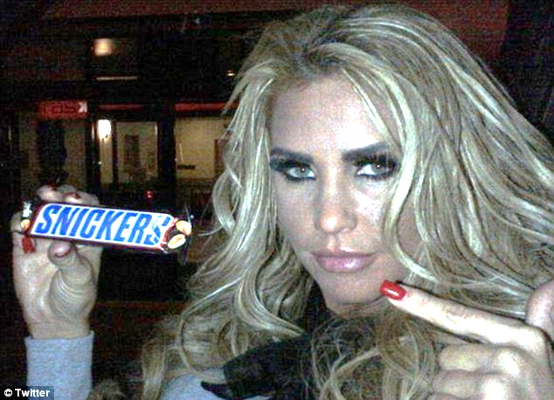
Complaint against Katie Price Tweet
"You're not you when you're hungry @snickersUk #hungry #spon"
Advertising Standards Agency – NOT UPHELD
Notes:
Devil is in the detail – KP – TV celebrity - Wrote out of character 'teasers' on Twitter – to her 1.5 million followers... one related to the Mars' product Snickers.
READ Caption
The ASA considered the combination of those elements including #spon (sponsorship) - was sufficient to make clear the tweets were advertising...
KATIE PRICE's previous tweets included "Large scale quantitative easing could distort liquidity of govt. bond market." so you probably might have guessed something was up.
20

Slide 21
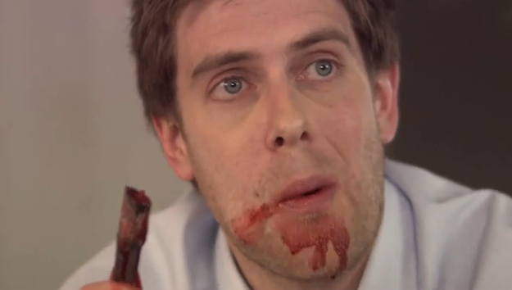

What if a Competitor/Employee uses Social Media ? Nestlé KitKat
    Greenpeace released a fake Kit-Kat commercial on Youtube accusing Nestlé of the use of palm oil and deforestation
    Nestlé attempted to get the video removed from Youtube
    Youtube accepted the removal of the video but the video was reposted by others
    Greenpeace used Twitter to criticise the censorship attempt
Notes:
21

Slide 22
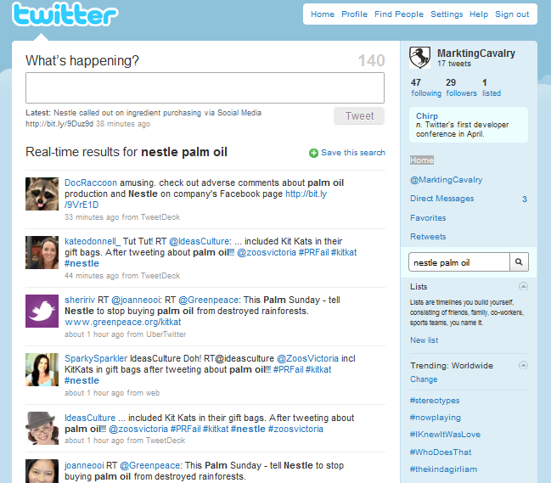
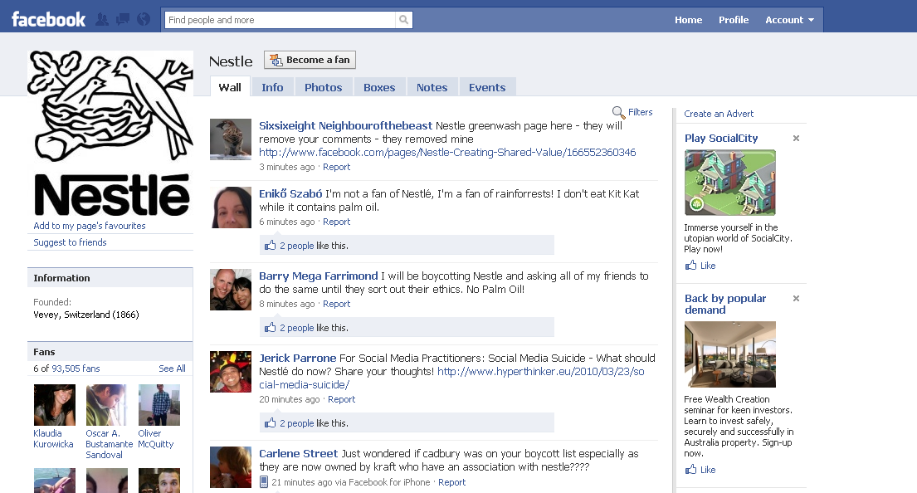
  Every 15 minutes a tweet regarding “palm oil” appeared
Notes:
22

Slide 23
https://www.asa.org.uk/resource/influencers-guide.html

Slide 24

ASA & CAP
From 14 June 2019
4.9 Marketing communications must not include gender stereotypes that are likely to cause harm, or serious or widespread offence
Joking is not a defence…

Slide 25
ASA & CAP
Advertisers should bear in mind that for claims on their own websites and in other non-paid-for-space online under their control to be classified as advertising, they must be “directly connected with the supply of goods, services, opportunities or prizes".
Very strict rules on the disclosure of ads, in other words being upfront and clear about when an ad is an ad, and we take action against advertisers who try and make ads look like editorial content.
It is important that any posts where the advertiser is paying the content-owner and has full editorial control over the message or visual being seen by the consumer, are labelled correctly with the word “ad” or “advert” to let consumers know this content was not spontaneously generated.
Ads that appear in-app or in-game should also be clearly labelled as ads and not disguised as part of the app’s or game’s content.
Advergames which typically are electronic games used to advertise a product, brand or an organisation are also covered by the advertising rules and should not mislead or cause harm and offence.

Slide 26
ASA or CMA ?
Ad ? Your brand controls claims, content & editorial
= CAP Code applies, ASA rules/informally resolves/sanctions
Sponsorship ? Your brand pays for an opinion, no control of content
= CMA investigates & enforces
Sanctions ?
= Named on website, Disqualified from industry awards – for ASA
= Formal Undertakings to CMA, contacts by CMA with all customers

Slide 27
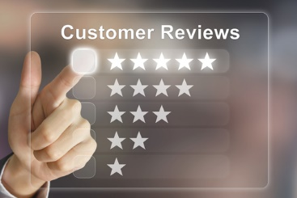


CMA investigated Online Reviews
… will ensure that any editorial content it uses to promote the products of a third party, where a trader has paid for the promotion, will make that fact clear in the content or through images or sounds clearly identifiable by the consumer.
have ceased the practice of writing fake reviews for their clients; and
will take steps to remove the fake reviews already posted online.
In addition, the CMA has written to Total SEO’s clients to warn them that third parties writing fake reviews on their behalf might lead to them breaking consumer protection law themselves.

Slide 28
Meta tags
What if a competitor uses meta tags to divert traffic away from your sites by using your brand in its HTML coding ?
Playboy was successful in claiming its trade mark was infringed
REED was not…

Slide 29
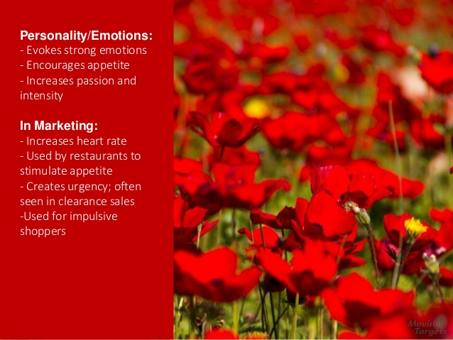
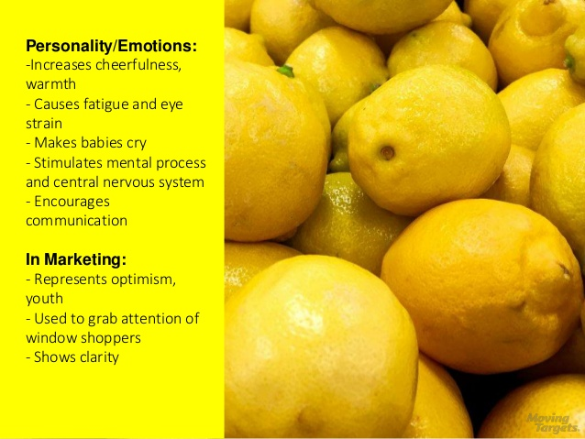
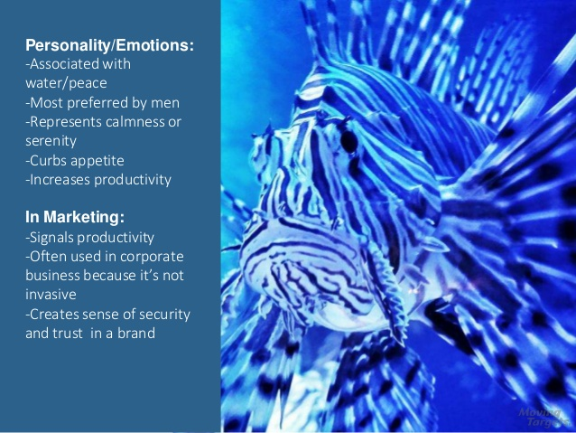
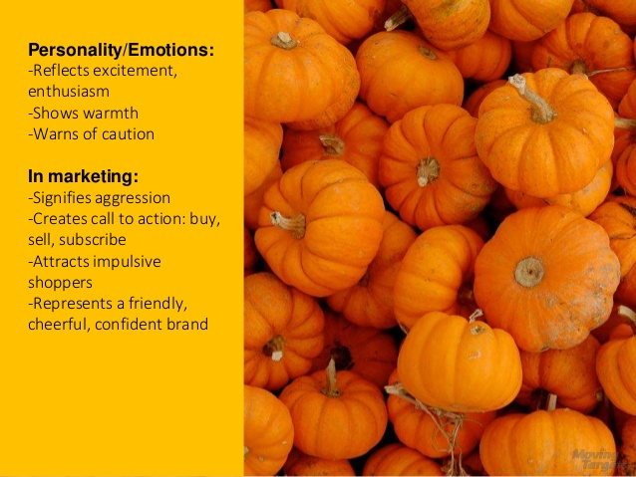

Slide 30
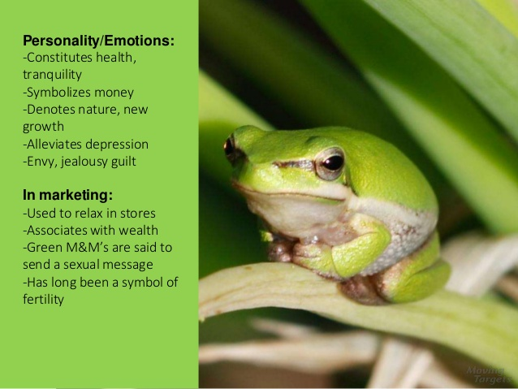
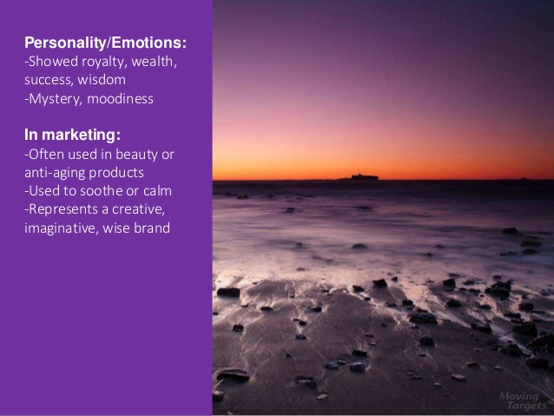

Slide 31
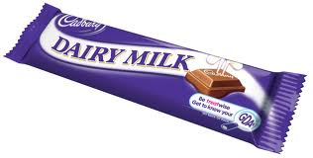
Colour as a Trade Mark
Colour is registrable as a trade mark if capable of distinguishing goods/services of one business from those of another
It can be difficult to establish that colour (on its own) identifies a particular business…
Nestlé SA opposed Cadbury UK seeking to register purple packaging
Cadbury had secured data & feedback, that showed how members of the public associated the colour purple itself with Cadbury's chocolate. Cadbury were entitled to apply for a registered trade mark for that colour for chocolate packaging.

Slide 32




Colour as a Trade Mark
Tiffany and Co.
Jewellery and various other items made of precious metal
UPS
Transport; packing and storing of goods; services with relation to delivery of letters
3M (Post it notes)
Stationery notes containing adhesive on one side for attachment to surfaces
Various domestic and industrial machinery
John Deere

Slide 33
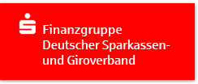

" German savings banks see red over Santander logo"
The German saving banks federation asked Santander to stop using the colour red in the German domestic banking sector and to remove it from their 350 branches.
This was followed up by a formal application for an injunction which was granted by the Hamburg court. Santander appealed the decision & a user licence was agreed.
“… surveys confirm that the German people identify the colour red not only with love, but also with the savings banks.”

Slide 34
Copyright

Slide 35
Rights in Data
  The database right
    - Protects databases not data
    - Where investment in obtaining verification or presentation
    - Infringed by acts of extraction or reutilisation of substantial part
    Also infringed by repeated extraction/reutilisation of insubstantial parts
  Database Copyright
    Protects databases – including Customer databases
    Higher originality threshold – selection or arrangement of data has to be author's own intellectual creation

Slide 36

Software
Copyright subsists in "original" literary and artistic works
Software Directive, Article 1(3) provides that a computer program shall be protected "if it is original in the sense that it is the authors own intellectual creation"
Copyright can subsist in:
      Computer program itself – source code and object code
      Preparatory materials and manuals
      Other copyright works incorporated into computer programs (design and layout of a screen, embedded sound and film, etc)
      The architecture of a computer system

Slide 37
Copying What ? Check ownership & price for use
Copyright prevents the whole or "substantial part" of copyright work being copied – includes photos, pictures, text…
Exceptions for research or for own use
Copying does not need to be intentional
  Unconscious recollection of code by programmer who then reproduces it would infringe in the same was as if intentionally memorised
Work does not infringe just because it is similar so long as no copying has taken place.

Slide 38
Open Source Software ("OSS")
Potential for conflicts between OSS licences and traditional proprietary licences.
Risk of core product portfolio becoming subject to T&Cs of an OSS licence.
Audit software to determine how much OSS is used.

Slide 39
Ownership/Copying by individuals
Software developed by a contractor who is not an employee will belong to the contractor in the first instance.
= Company should ensure it takes an assignment of the software.
Risk of copying by third party developers/competitors.
Include "sleepers" – lines of code with no function, to identify the origin of the software.

Slide 40
Copyright and Anti-Circumvention Laws
Copyright law prevents the circumvention of technological barriers for using computer programs in ways which the right holders do not wish to allow.
Use of Messiah ‘chips’ in Playstation 2s enabled users to play games which had been copied or which were from other countries.

Slide 41
Domain Names & Cybersquatting
https://easily.uk/ provides a practical route to securing a domain name.
There is no legal action called "domain name infringement“ – so if someone is cybersquatting your brand name, you must follow the dispute resolution procedures set by ICANN & other organizations.
Ensure that if a brand agency is registering a domain name for your business, that your business will receive an assignment of this name, royalty free.

Slide 42

Design Rights
Registering a design rights grants you a monopoly for up to 25 years, to enable you to stop others from making, selling or using a product which incorporates your design.
Registering a 2 D image as a design gives a monopoly on the application of the image to products, which is wider than protection given by a trade mark (‘same or similar marks’ are protected).
To be registrable, a design must:
  be new; and
  have individual character, which means that the overall impression of the design must differ from previous designs.
easyGroup has registered "easy.com" as a trade mark and its orange and white "easy.com" logo as a registered design for use with clothing and travel goods

Slide 43
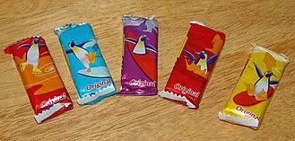

Passing Off
You must prove:
Your business has established goodwill and reputation in the brand;
that another business is using a brand which is similar to or the same as the owner's brand;
that, by doing so, it may cause the public to be confused into thinking that it is associated with the business of the owner of the brand; and
that it causes actual damage to the business or goodwill of the brand owner.
It is generally not easy to prove passing off, particularly as you must provide data from surveys to show the possibility of confusion or actual confusion.
It can be very difficult, slow & expensive to obtain survey data.

Slide 44
E- Commerce & Customers
E-Commerce Regulations 2002 impose a range of obligations on operators of commercial websites, in particular obligations to provide users with certain information about the operator and its services.
• Consumer Rights Act 2015 has updated rights of consumer who agree to e-contracts and their rights to request a refund or return.
• Consumer Contracts (Information, Cancellation and Additional Charges) Regulations 2013 impose additional obligations on website operators who deal with consumers.
• Consumer Protection From Unfair Trading Regulations 2008 prohibit various unfair practices, such as misleading actions or omissions, and include a "blacklist" of prohibited commercial practices.

Slide 45
Data Privacy & e-Marketing
The General Data Protection Regulation (GDPR) and Data Protection Act 2018 regulate the use of personal data, including customer data.
• The Privacy and Electronic Communications (EC Directive) Regulations 2003 apply to direct marketing (both solicited and unsolicited) by means of electronic communication.
A new e-Privacy Regulation is currently in proposal form, but will not come into force in Europe until 2019 at the earliest.

Slide 46
Cookies ?
Website operators cannot store information or gain access to information stored in the computer of a customer, unless the customer is provided with clear and comprehensive information about the purpose of such storage or access and has consented to it.
This means you must:-
display an online cookies notice, with details of the categories of any cookies used
using a mechanism that enables positive consent (by means of a tick box or "click through" overlay).
This does not, apply to cookies which are strictly necessary to provide an online service requested by the customer.

Slide 47
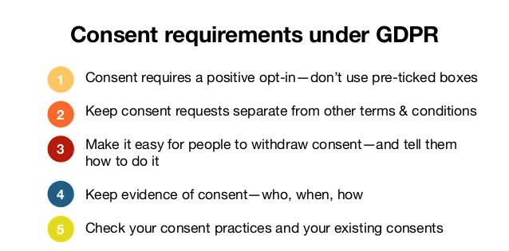

Slide 48
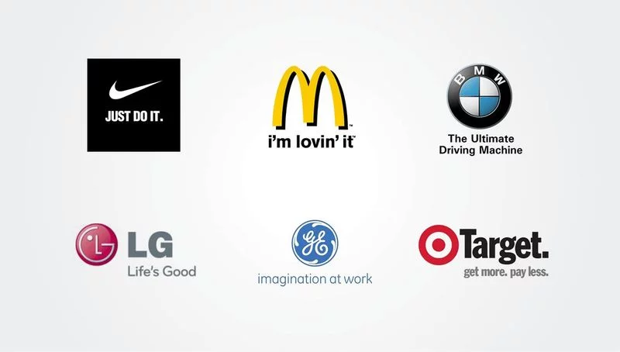

Slide 49
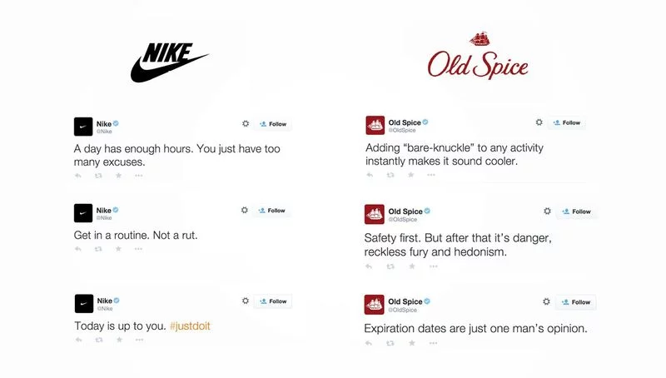

Slide 50
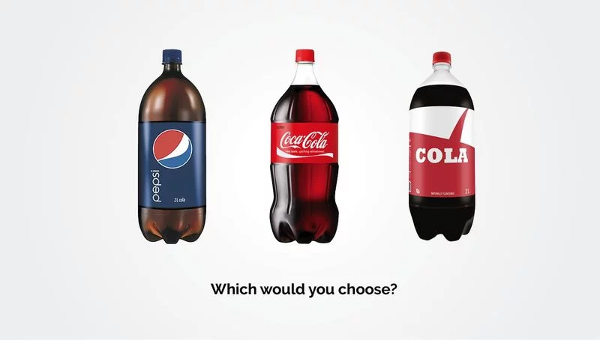

Slide 51
How will you protect your brand online ?
Let me know & thank you for all questions…
Helen.ar.Roberts@gmail.com

Slide 52
Further Information on Trade Marks

Slide 53
What is a Trademark?
“A sign distinguishing goods or services produced or sold by one business”.
When registered & used, with payment of fees, it can provide indefinite protection for a brand.

Slide 54




A TRADEMARK IS MADE OF :
Any Distinctive Words, Letters, Numerals, Pictures, Shapes, Colors, Logos, Labels

Slide 55
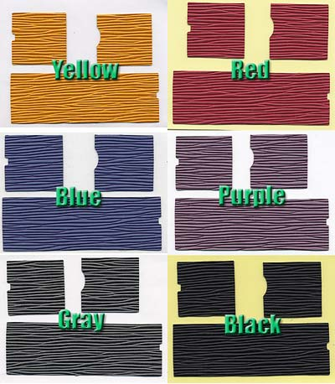


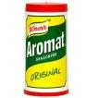
Less traditional marks
Single colors (Louis Vuitton)
Three-dimensional signs
(shapes of products
or packaging)
Audible signs (sounds)
Olfactory signs (smells)
Notes:
Audible signs: meaning sounds such as the jingle of the NOKIA tune or the sound of an engine to evoke the Harley Davidson motorcycle
Olfactory signs: specific smells used in a much less traditional way as a trademark

Slide 56



Types of Trademarks?
Trade marks: to distinguish goods (*)
Service marks: to distinguish services
Collective marks: to distinguish goods or services by members of an association
Certification marks
Well-known marks: benefit from stronger protection
Tradename (Brand name) (*)
Notes:
Collective marks: usually owned by an association or cooperative whose members may use the collective mark to market their products - it is the association that establishes a set of criteria for using the collective mark and individual companies can use it if they comply with such standards.
Certification Marks: are given for compliance with certain standards but are not confined to membership of an association or cooperative. The Woolmark symbol is one such example.
Well-known marks are considered well known by the competent authority in the country and may be protected even if they are not registered in a given territory.

Slide 57
The function of a Trademark
Allows companies to mark A TERRITORY, EXPRESSING specific functions among similar products in the market.
Ensures that consumers can identify a line of products.
Ensures extension of the mark through licensing or franchising process.
Notes:
Trademarks play a pivotal role in the branding and marketing strategies of companies. TM in fact contribute to defining the image and reputation of a company’s product in the eyes of a consumer.

Slide 58
The value of a Trademark?
A marketing tool
A source of revenue through licensing
A crucial component of franchising agreements
Useful for obtaining banks or third part finance
A valuable business asset

Slide 59
Trademark protection & Registration
Exclusive rights prevent others from marketing products under same or confusingly similar mark
Secures investment in marketing efforts
Promotes customer loyalty/ reputation / image of company
Provides coverage in relevant markets where business operates
Registered marks permit license or basis franchising agreements

Slide 60
PRACTICAL STEPS
Create or buy a trademark (after searching worldwide to find out that there are no similar registered ones – to reduce risk of refusals or oppositions
Protect your trademark through your national or regional office and then extend it to the world (WIPO Madrid & Protocol System)
Use and maintain your trademark(s) (paying fees, following notification of refusals, extending territory)
Enforce your trademark(s), innovate (develop new products)

Slide 61
What to avoid when selecting a Trademark
Generic terms: CHAIR to sell chairs
Descriptive terms: SWEET to sell chocolates
Deceptive terms: “ORWOOLA” or “Pure whool” for 100% synthetic material
Marks and terms contrary to decency
  “Tiny Penis. The Worlds Most Outrageous T-Shirts”.
Notes:
When choosing a trademark for your product or service, keep in mind what you should NOT choose as a trademark so that your choice does not end up being rejected by the trademark office.

Slide 62
Protecting a TM through registration
The applicant can file a request at his national office and then at WIPO which offers free assistance, information & guidelines for:
  Filing application forms, contact details, fees
  Registration and certificate valid for 10 years
  Renewal services & publication (CD-ROMs /Gazette)
The IP national office is the only authority in charge of :
  Formal examination
  Substantive examination
  Publication and opposition
Notes:
While filling in a TM application, you are required in most countries to indicate the good and services under which you wish to register your trademark and group them according to classes which refer to the trademark classification system. It is critical to register your trademark in all classes in which you use or intend to use your trademark. The most widely used classification system (Nice0 has 34 classes for goods and 11 for services.
Some TM offices such as in US and Canada require the proof that the TM is used
A substantive examination may be required if there is a conflict with an existing Mark on the register
Some countries publish the TM in a journal allowing 3rd parties to oppose during a given period
Once it is decided that there is no grounds for refusal, a certificate is issued which is valid for 10 years.
Registration can be renewed indefinitely but may be cancelled if TM is not actively used for a certain period stated in the TM law.

Slide 63
Scope of Rights
The exclusive right to use the mark
The right to prevent others from using an identical or similar mark for identical or similar goods or services
The right to prevent others from using an identical or similar mark for new goods or services

Slide 64
BE AWARE OF
The time & resource it takes to register a TM
The costs associated with registration & protection
The need for a trademark search
A trademark agent may be required
Protecting at home and abroad
Deadlines for Renewing your registration

Slide 65
USING A TRADEMARK
Actively using a TM
Using/maintaining a TM in marketing and advertising
Using the mark on the internet
Using the mark as a business asset

Slide 66
ACTIVELY USING A TRADEMARK
Offering goods or services
Affixing the mark to the goods or their packaging
Importing or exporting the goods under the mark
Using it on business papers or in advertising
Notes:
Once TM is registered, it is important to use it or else run the risk of loosing your right to the TM

Slide 67
USING A TRADEMARK IN ADVERTISING
Shall be used exactly as registered
Protect TM from becoming generic
  Set apart from surrounding text
  Specify font, size, placement and colors
  Use as an adjective not as noun or verb
  Not plural, possessive or abbreviated form
  Use a trademark notice in advertising and labeling ®
Monitor authorized users of the mark
Review portfolio of trademarks
An evolving trademark
Notes:
Monitor those authorized to use the TM to control quality of goods and services offered under licensed mark
Conduct annual checks to ensure that all TM are registered and renew registrations if necessary
Evolving mark: there are no restrictions on modifying a TM but should check with TM office procedure and cost of the change

Slide 68
USING A TRADEMARK AS A BUSINESS ASSET
Licensing: owner retains ownership and agrees to the use of the TM by other companies in exchange of royalties > licensing agreement (business expansion/diversification)
Franchising: licensing of a TM central to franchising agreement.The franchiser allows franchisee to use his way of doing business (TM, know-how, customer service, s/w, shop decoration, etc)
Selling/assigning TM to another company (merger & acquisitions/raising of cash)

Slide 69
ENFORCING TRADEMARKS
Responsibility of trademark owner to identify infringement & take steps
“ Cease and desist letter” to alleged infringer (s)
Search and seize order
Cooperation with customs authorities to prevent counterfeit trademark goods
Arbitration and mediation (preserve business relations)

Slide 70
